Slide 1
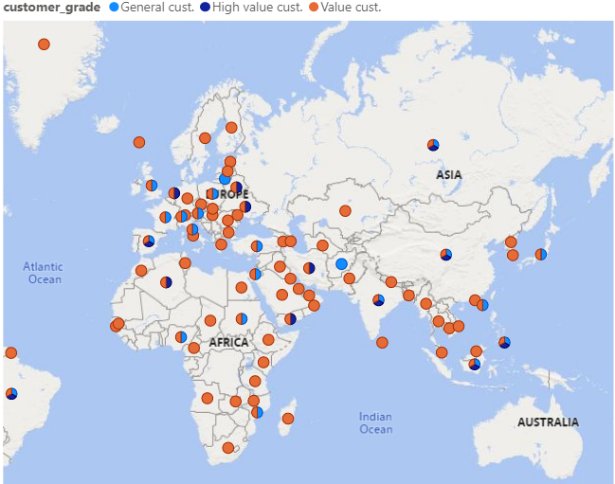
1.Define customer grade on each country
High value customer (spent > 150 $)
Value customer (spent70 - 150 $)
High value customer (spent < 70 $)
Objective : To focus on country which most people love to spend money on DVD rental service. We want to know customer behavior ,who live on each country in different continent, and love to spend on renting DVD.
Then, grading the customer from how much they spent.
1.In Europe, most people love to spending on rental DVD whereas in Australia and Asia, few people spend on rental DVD service.
2.There are 12 countries which has high value customer located around the world.

Slide 2
2.Which category is the most favorite among renter ?
Juggler Hardly (32 times)
Objective : To find the most favorite film category and which film has been rent the most?
Scalawag Duck (32 times)
As you can see on the bar graph, it shows that the most popular one is Animation DVD whereas the least popular is music DVD.
Although music DVD is the least popular category which customer prefer to rent, there are 2 DVD lists claimed that the most rent (32 times)
As show in the bar graph and it is Scalawag Duck

Slide 3
3. Distribution of each film category calculated by rental duration
These are show only top 6 categories which have the greatest number of film
Objective : To see the distribution of top 6 categories calculated by duration of rent
Rental duration
Rental duration
Rental duration
As you can see on the distribution graph, there are 3 cats ,which sports,documentary,animation, tend to have lower rental duration while the rest which, family,foreign,drama, tend to have higher rental duration.
Thus, we could predict the trend in the future and indicate behavior of film and duration
25%
50%
75%
100%
25%
50%
75%
100%
25%
50%
75%
100%
Percentile
Percentile
Percentile
Rental duration
Rental duration
Rental duration
25%
50%
75%
100%
25%
50%
75%
100%
25%
50%
75%
100%
Percentile
Percentile
Percentile

Slide 4
4.Who is the most effective staff from both store1&2 compared by KPI ?
Objective : To see the performance of staffs from any store
In order to measure the performance of staff, we can’t only see the payment from staff generated but also need to know how many customer that the staff can’t persuade to rent the DVD.
As you can see on the graph, we shall see KPI from each staff in very similar figure. However, Jon got slightly higher KPI than Mike.

